Slide 1
¹⁰ Finally, be strong in the Lord and in his mighty power. ¹¹ Put on the full armor of God, so that you can take your stand against the devil’s schemes. ¹² For our struggle is not against flesh and blood, but against the rulers, against the authorities, against the powers of this dark world and against the spiritual forces of evil in the heavenly realms. ¹³ Therefore put on the full armor of God, so that when the day of evil comes, you may be able to stand your ground, and after you have done everything, to stand. ¹⁴ Stand firm then, with the belt of truth buckled around your waist, with the breastplate of righteousness in place, ¹⁵ and with your feet fitted with the readiness that comes from the gospel of peace. ¹⁶ In addition to all this, take up the shield of faith, with which you can extinguish all the flaming arrows of the evil one. ¹⁷ Take the helmet of salvation and the sword of the Spirit, which is the word of God. Ephesians 6:10-17 NIV
SPIRITUAL EQUIPMENT TO PREPARE FOR SERVICE

Slide 2
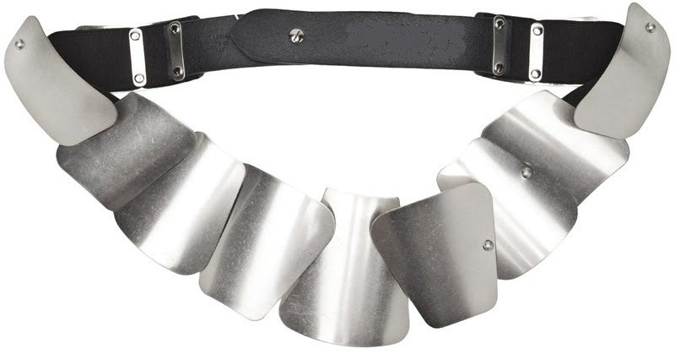
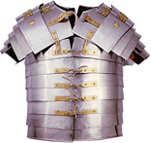
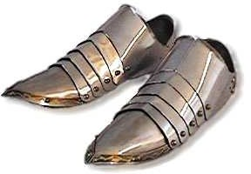
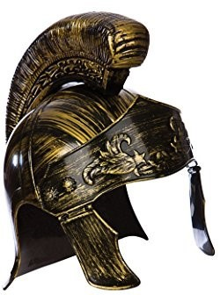
SPIRITUAL EQUIPMENT (“the armor of god”) for preparing TO REACH OUR POTENTIAL
3. Our feet fitted with the readiness that comes from with the gospel of __ __ __ __ __
1. The belt of __ __ __ __ __
2. The breast plate of
__ __ __ __ __ __ __ __ __ __ __ __ __
5. The helmet of
__ __ __ __ __ __ __ __ __
6. The sword of the Spirit, which is the __ __ __ __ of __ __ __
4. The shield of __ __ __ __ __

