Slide 1
ENVISIONING OUR POTENTIAL
IN THE SERVICE OF KINGDOM BUILDING

Slide 2
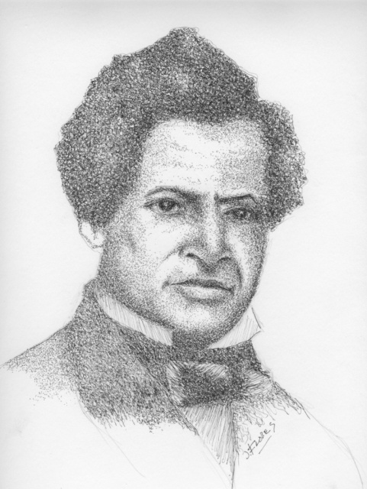
PERSONAL POTENTIAL
Family Life
Personal Life
Workplace
Community
Church

Slide 3
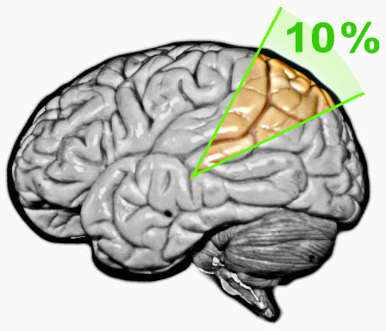

Slide 5
= Making Disciples

Slide 6
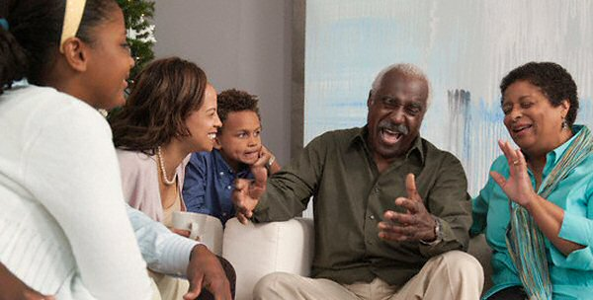
Area 1. witnessing for Kingdom-Building in Our homes

Slide 7
Area 2. witnessing for Kingdom-Building with Our Friends

Slide 8
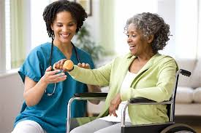
AREA 3. witnessing FOR KINGDOM BUILDING IN THE WORKPLACE

Slide 9
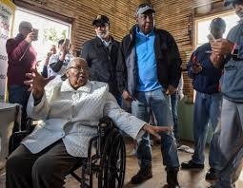
AREA 4. witnessing FOR KINGDOM BUILDING IN THE community

Slide 10
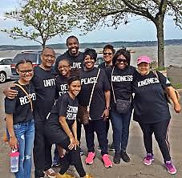
AREA 5.
SERVICE FOR
KINGDOM-BUILDING
IN THE CHURCH
Members
St. Philips AMEZ Church
Nyack, NY

Slide 11
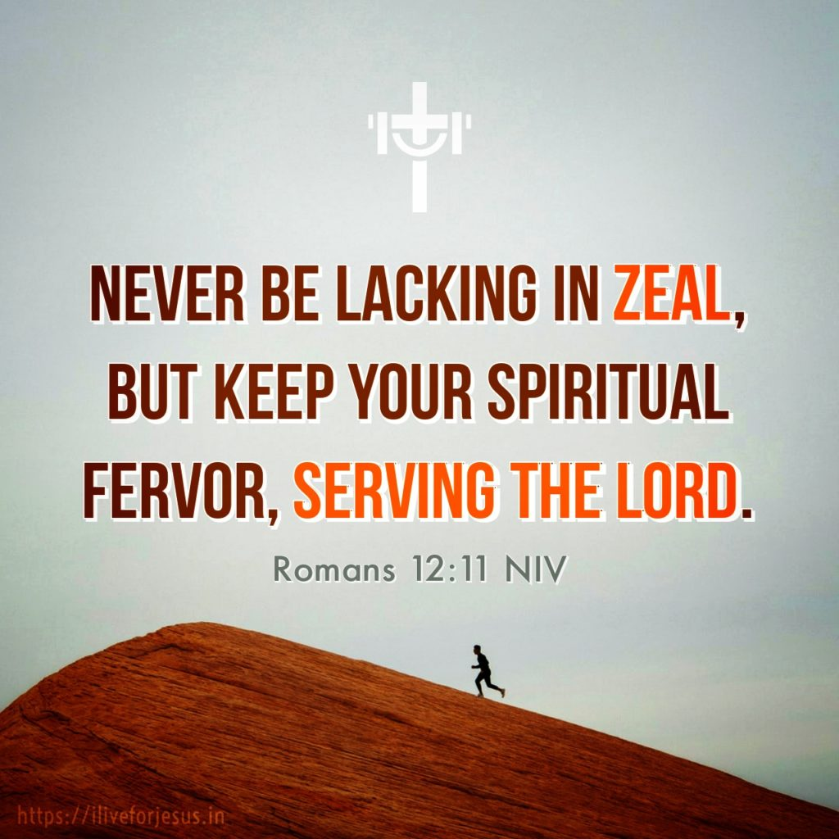

Slide 12
reaching OUR POTENTIAL: witnessing & serving for Kingdom building
Home
Personal life
workplace
Community
church

